Slide 1
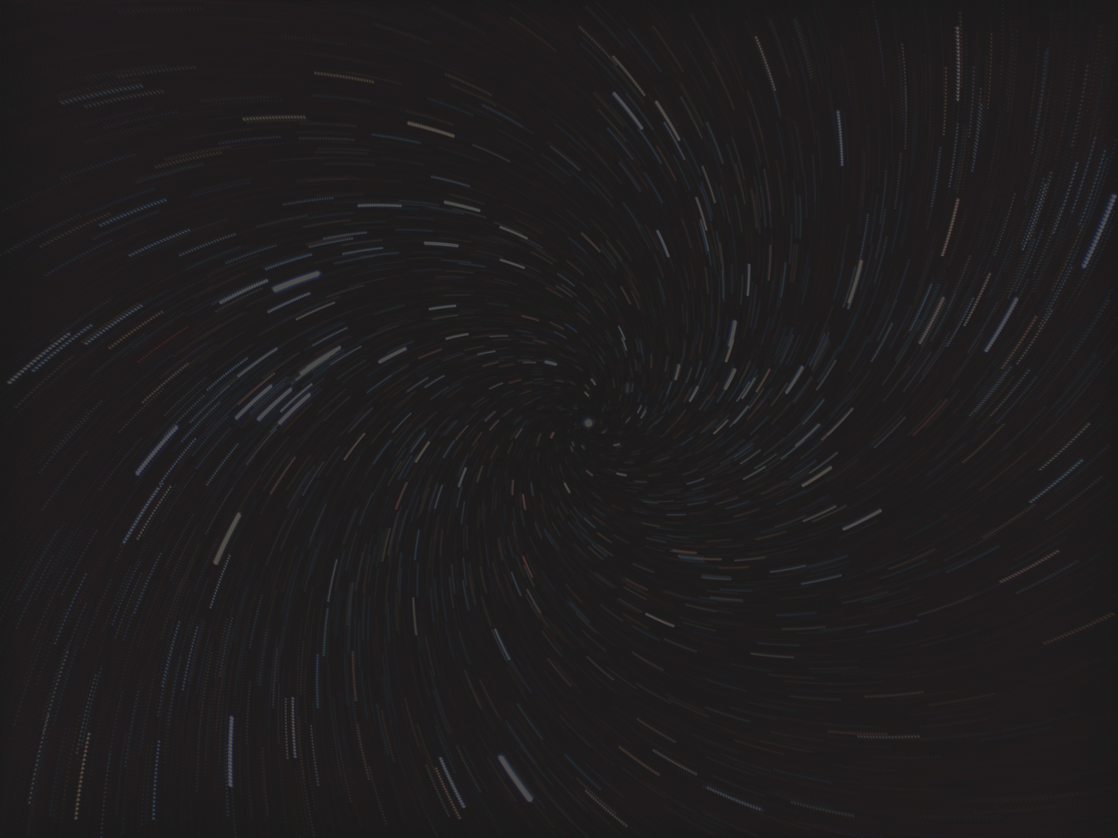


BARCODE
DETECTION

Slide 2
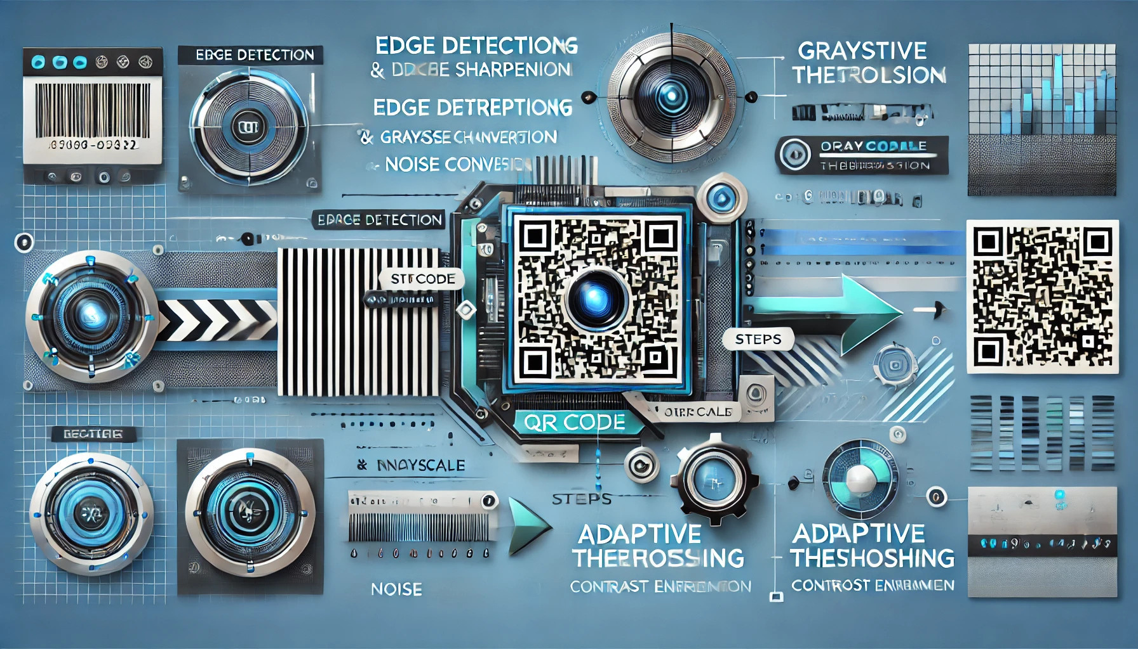
PROBLEM FORMULATION
Detecting and decoding barcodes and QR codes from images or live video feeds can be challenging in low-quality or noisy environments.
Many scanners fail due to poor lighting, noise, or lack of preprocessing.

Slide 3
PROBLEM FORMULATION
Objective:
Develop a program that uses advanced image processing techniques to enhance input quality and improve detection accuracy for barcodes and QR codes.

Slide 4
OVERVIEW OF THE SOLUTION
Approach
Enhance image quality using preprocessing techniques.
Apply specialized algorithms to detect and decode barcodes and QR codes.

Slide 5
OVERVIEW OF THE SOLUTION
Key Components:
Edge detection.
Image sharpening.
Noise reduction.
Contrast enhancement.
Barcode and QR code detection and decoding.

Slide 6
METHODOLOGY
01
Image Input
Input an image from a live camera or a static file.
Load the frame using OpenCV
02
Edge Detection
Apply a Sobel-like kernel to highlight vertical edges.
Purpose: Enhance barcode structures.
03
Image Sharpening
Use a sharpening kernel to improve clarity.
04
Grayscale Conversion
Convert the sharpened image to grayscale for simplicity

Slide 7
METHODOLOGY
05
Noise Reduction
Apply Gaussian blur to reduce noise and smooth the image
06
Adaptive Thresholding
Create a binary image for better contrast between the code and background
07
Contrast Enhancement
Apply CLAHE to improve visibility of codes in low-contrast areas.
08
QR Code Detection
Use OpenCV's QRCodeDetector to locate and decode QR codes.
Mark detected codes on the image.

Slide 8
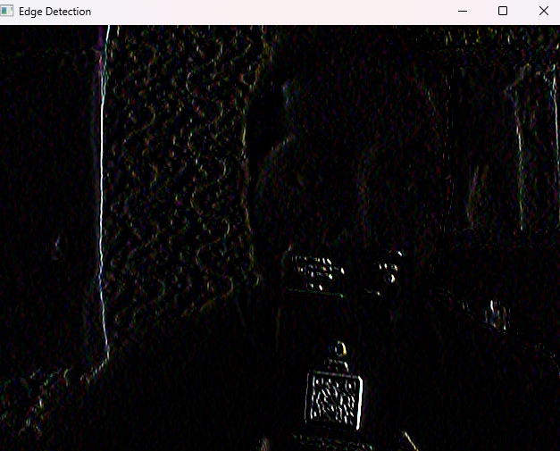
METHODOLOGY (CONT)
Edge detection
Define a mask (kernal)
([[1, 0, -1],
[1, 0, -1],
[1, 0, -1]])
Apply 2D convolution for edge detection

Slide 9
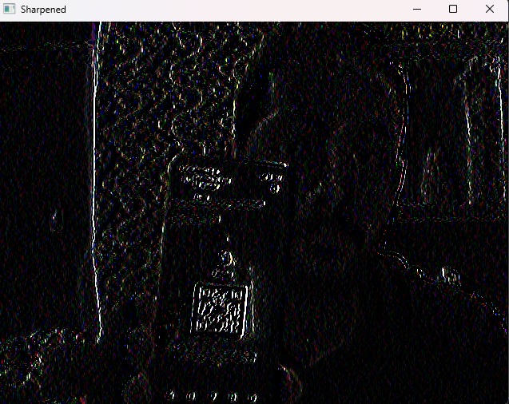
METHODOLOGY (CONT)
Image sharping
Define sharpening kernel
([[ 0, -1, 0],
[-1, 5, -1],
[ 0, -1, 0]])
Apply 2D convolution for sharpening

Slide 10
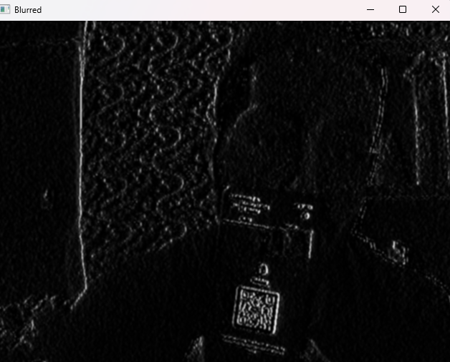
METHODOLOGY (CONT)
Grayscale Conversion
gray = cv2.cvtColor(sharpened, cv2.COLOR_BGR2GRAY)
Noise Reduction
blurred = cv2.GaussianBlur(gray, (5, 5), 0)

Slide 11
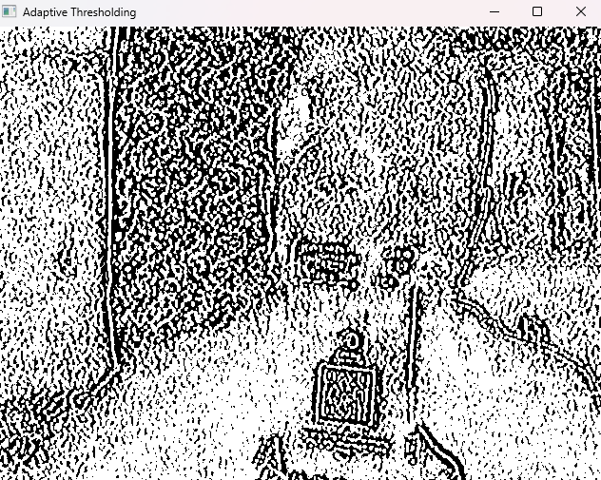
METHODOLOGY (CONT)
Adaptive Thresholding
adaptive_thresh = cv2.adaptiveThreshold(blurred, 255, cv2.ADAPTIVE_THRESH_GAUSSIAN_C,
cv2.THRESH_BINARY, 11, 2)

Slide 12
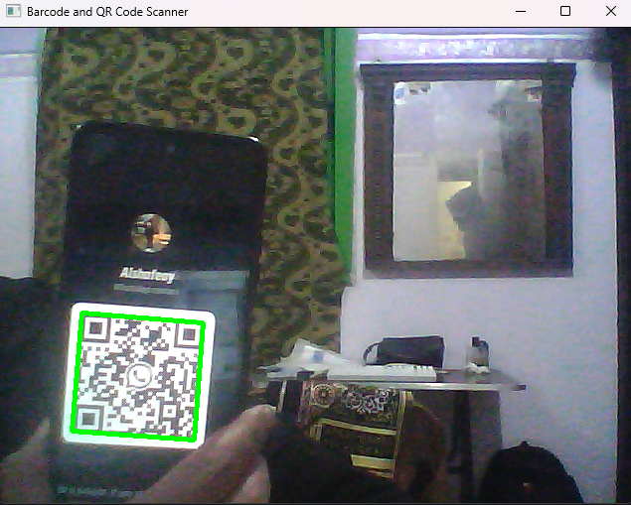
METHODOLOGY (CONT)
Contrast Enhancement
clahe = cv2.createCLAHE(clipLimit=3.0, tileGridSize=(8, 8))
enhanced_gray = clahe.apply(adaptive_thresh)

Slide 13
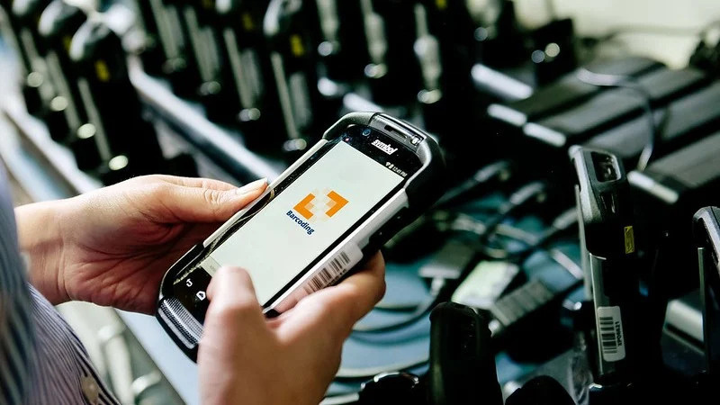
Real-Time Scanning
Live detection and decoding.
Supports both barcodes and QR codes
.
Static Image Processing
Outputs intermediate and final results as image files.
RESULT

Slide 14

AHMED ALSHAFEAY 225236
ABDELRAHMAN SAMI 225256
ABDELRAHMAN AHMED 225278
YOUSEF ELSAFTY 225267
ASHRAF GHONIM 225115
AYA ESSAM 225105

Slide 15
THANK YOU

